Slide 1

Tokeners
Zarf Token
Page
01

Slide 2
Tokeners
Introduction
Objective: Added 5 core features to enhance Zarf Token utility
My
Reservations
Password
Recovery
Court
Creation
Cancelling
Reservations
Free-Spot
Notifications
Page
02

Slide 3

Tokeners
Court
Creation
There is no streamlined way for the Events Office to create or manage sports courts.
Page
03

Slide 4

Tokeners
Court
Creation
NOW! The Events Office can dynamically create and list new courts by simply defining the Name, Type, and uploading an Image.
Page
04

Slide 5

Tokeners
Court
Creation
Seamless Addition
Custom Configuration
Instant Availability
Allows the Events Office to simply add new facilities to the system without needing technical support.
Defines specific attributes like Name and Type to ensure accurate categorization for bookings.
Immediately makes the new court available on the platform for students to view and book.
Page
05

Slide 6
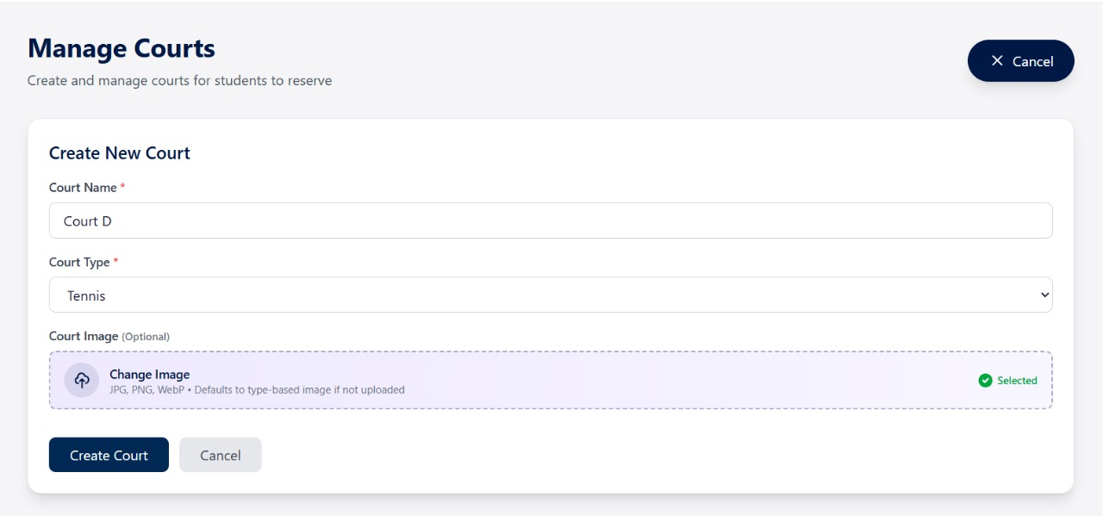
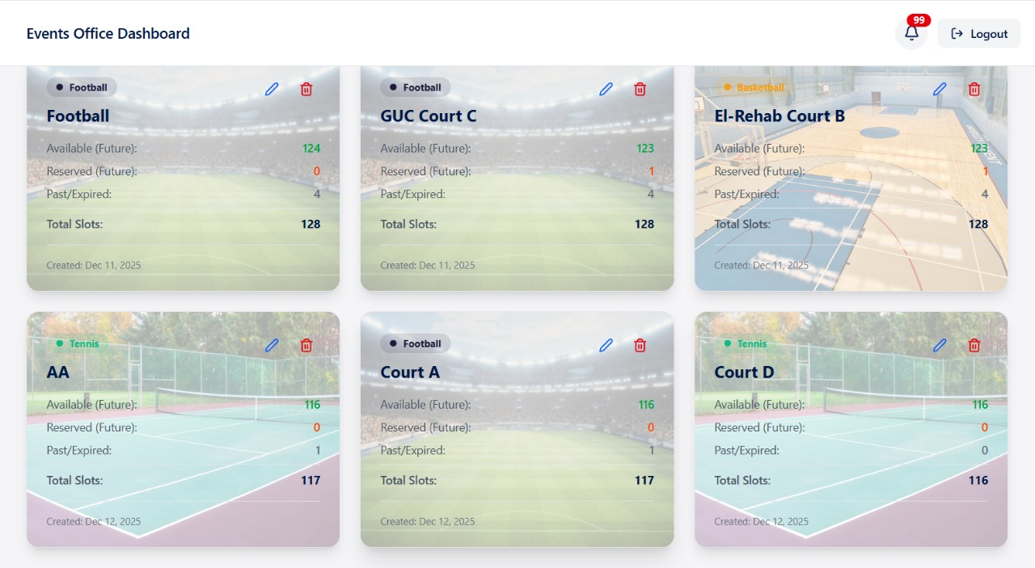
Tokeners
Court
Creation
Page
06

Slide 7


Tokeners
Court
Reservation
Students currently have no way to track their booking status or view their upcoming schedule.
Page
07

Slide 8
Tokeners
Court
Reservation
NOW! Students Can easily view all
court reservations .
Track Date & Time
So That,
Identify Court number
Page
08

Slide 9
Tokeners
Reservation
Cancelling
Students cannot remove unwanted bookings, leading to wasted court slots and blocked access for others.
Page
09

Slide 10


Tokeners
Reservation
Cancelling
Provided a seamless cancellation button that optimizes court availability
Page
10

Slide 11
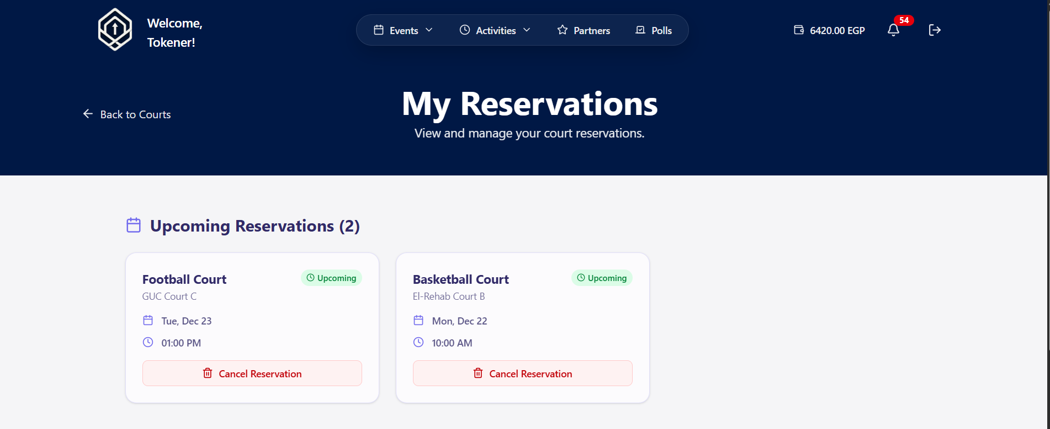
Tokeners
Reservation
Page
Page
11

Slide 12

Tokeners
Password
Recovery
No secure mechanism exists for users to regain access after losing their password.
Page
12

Slide 13
Tokeners
Password
Recovery
Secure Access Recovery for All Users
Student
TA
Staff
Professor
Vendor
Page
13

Slide 14
Tokeners
Password
Recovery
The Logic Flow
1
clicks "Forgot Password?"
4
Mail is sent to the user
2
User enters their registered Email
User updates his password
5
3
6
System validates the user exists in the database
Database is updated, and the user is redirected to Login
Page
14

Slide 15
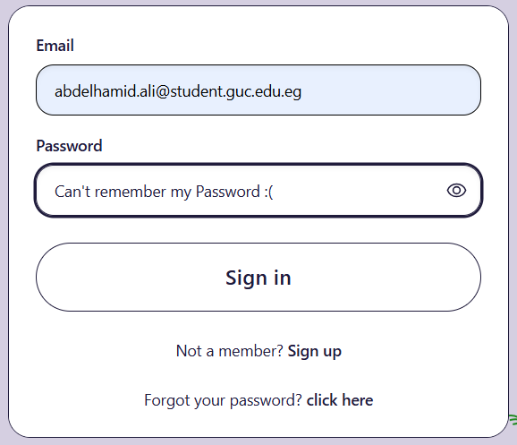
Tokeners
Password
Recovery
Page
15

Slide 16

Tokeners
Free-Spot
Notification
Students unknowingly miss the opportunity to join sold-out events because they are not alerted when a spot frees up later.
Page
16

Slide 17
Tokeners
Free-Spot
Notification
1
Added a notification request button.
2
student clicks it
3
be notified as soon as a spot becomes available.
Page
17

Slide 18
Tokeners
Free-Spot
Notification
Capacity Validation
Second Chance
Zero Manual Effort
The system validate that the event is currently at 100% capacity before enabling this feature.
Provides a backup opportunity to attend previously sold-out events.
Eliminates the need for students to repeatedly check for free spots.
Page
18

Slide 19
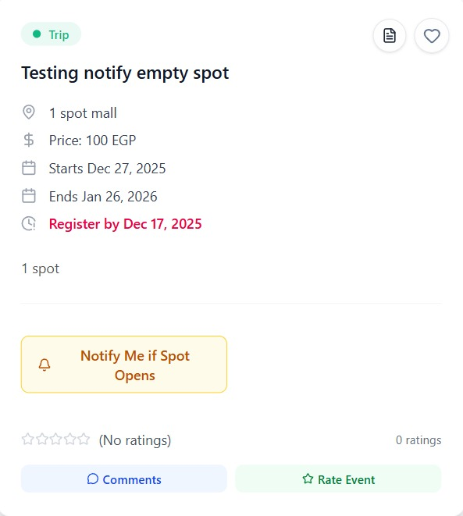
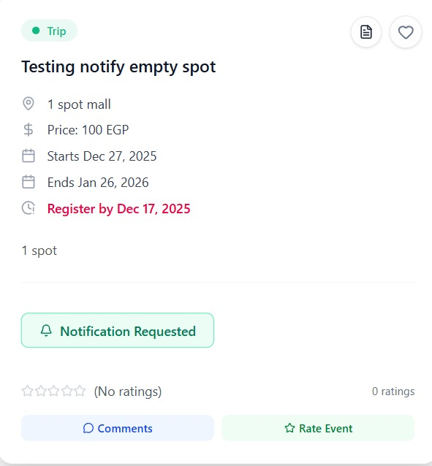
Tokeners
Free-Spot
Notification
Page
19

Slide 20
Tokeners
Conclusion
Key Deliverables
Enabled the Events Office to dynamically create and list
Court Management
Enabled the Students to view and cancel court reservations in a seamless way.
Change Password
Added a "Forgot Password" workflow for instant access recovery for All Users.
Free-Spot Notification
Automatically alerts Students when space becomes available.
Page
Page
20

Slide 21
Tokeners
Questions?
Page
Page
21

Slide 22
Tokeners
Thank
You.
Page
Page
22

